Slide 1

Weekly Review
06/04/21
Tasks
Conduct experiments and evaluate results using GUI and plots ⚠️In progress
Problems
Results of experiment unexpected
To-Do Items for Next Week
Compare organization of current repo with RLPYT original repository
Update states, values, rewards till you get
Define more reward functions, states, actions for our use case
To-Do Later
Explore usage of intermediate testing on simulation before sim-to-real transfer
Define use-case (for different type of towels (colour, texture, etc. ) / one type )

Slide 2
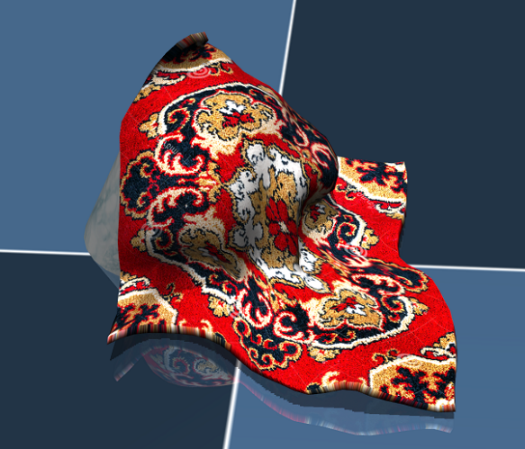
Cloth Manipulation using SAC
06/04/21
SACAgent
Observation
(64*64 img)
Action
Pick point and place point
From random pixel points
Inside segmented mask
Agent
Reward
(Overlap with goal state)
Environment (Mujoco)

Slide 3
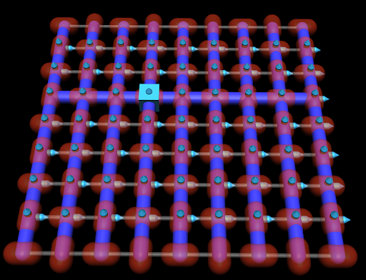
RL Problem for obtaining one flat seam
06/04/21
Goal
Obtain one flat seam
Given
Cloth in mujoco represented by 64 particles in 8*8 grid
Observations
[x,y,z] positions of 4 points adjacent to corner 1
Actions
Random [x,y] movement of corner 1
Corner 1

Slide 4
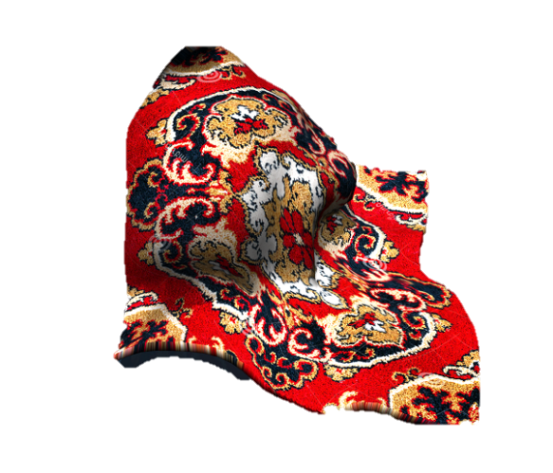
RL Problem for obtaining one flat seam
06/04/21
Goal
Obtain one flat seam -> Corner particle + 3 adjacent particles in a straight line
Reward
Join 1st point and last point
Project on x,y plane
3. Reward is proportional to :
-1 * (x,y,z) distance from the ideal line
Step 1
Step 2
X
X
X
X
0.3
0.3
0.3
Step 3
z = 0

Slide 5
Approach testing now
06/04/21
Algorithm
Take random actions for initial N steps
Store observations, actions, next observations, rewards
Filter the stored data for rewards > -0.010 (Good rewards)
Select states and actions from filtered data
Define a single layer NN
Train the NN on states and actions from filtered data
Predict actions for new observations after the initial N steps
Check results
Update NN network (Add more layers / nodes )
Repeat Steps 6-10 till the results are satisfactory
Next Steps
Include more networks from the SAC implementation
Train on full SAC implementation

Slide 6
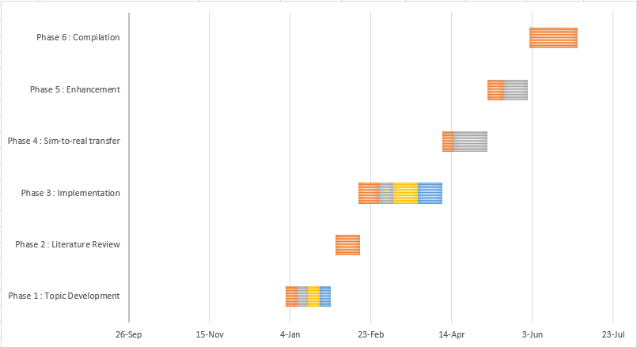
Plan
06/04/21
Phase 3 : Implementation : 52 days (mid Feb- early Apr)
Setting up the Reinforcement Learning Platform and Simulation environment : 13 days
Prepare a custom implementation taking existing states, actions, rewards : 9 days
Redefine actions and rewards for our use case : 15 days
Test the pipeline and iterate : 15 days

Slide 7
THANK YOU

